Slide 1
Max flow and flow network
FORD FULKERSON

Slide 2
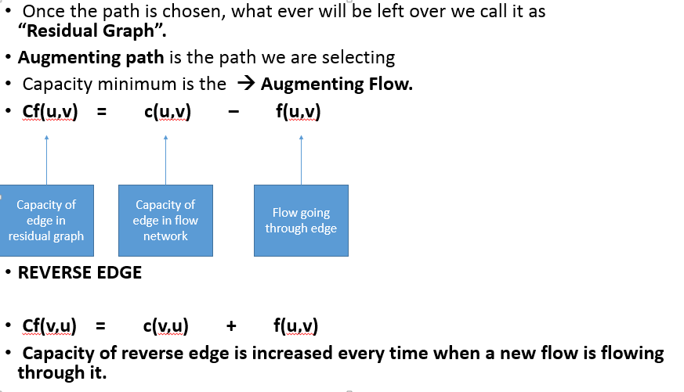

Slide 3
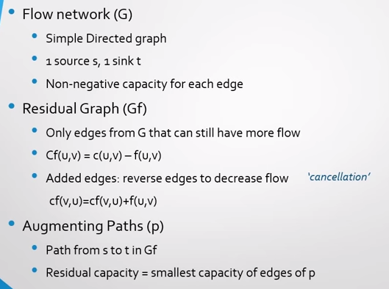

Slide 4
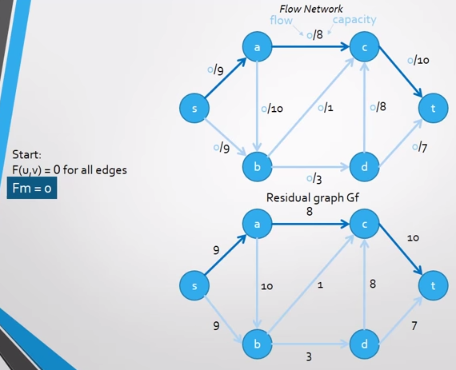

Slide 5
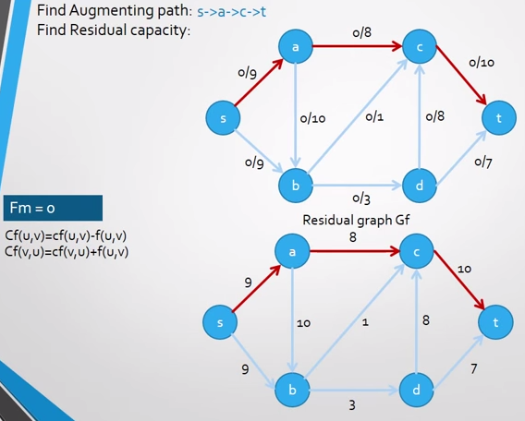

Slide 6
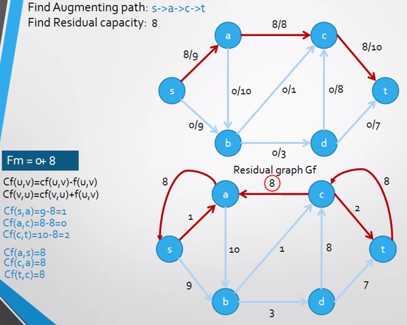

Slide 7
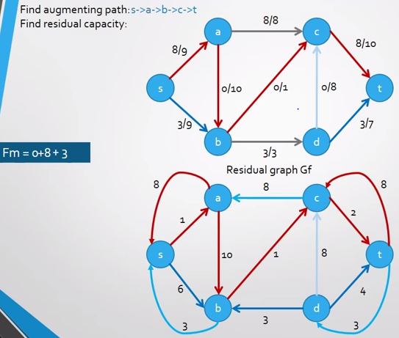

Slide 8
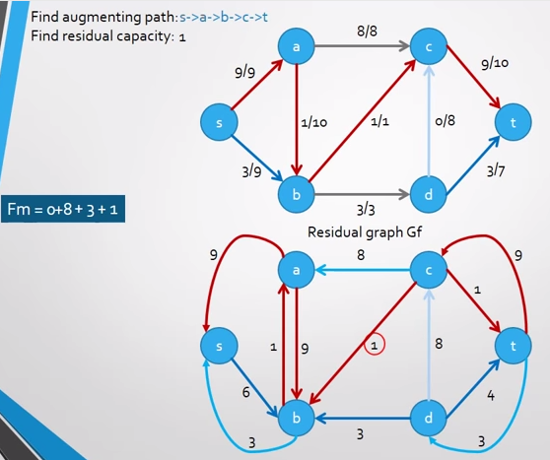

Slide 9
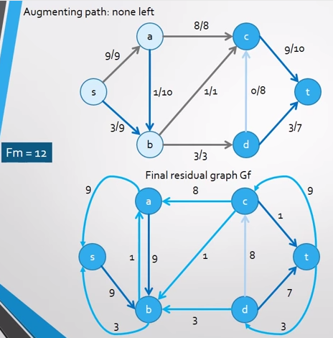

Slide 10
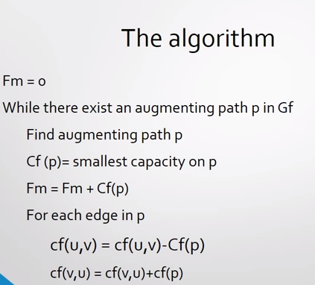

Slide 11
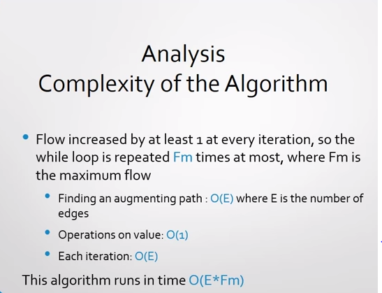
Update the maximum flow, and capacities on the edges

Slide 12
Ford-Fulkerson Max Flow
4
2
5
3
1
1
1
2
2
s
4
t
3
2
1
3
This is the original network, and the original residual network.

Slide 13
Ford-Fulkerson Max Flow
4
2
5
3
1
1
1
2
2
s
4
t
3
2
1
3
Find any s-t path in G(x)

Slide 14
Ford-Fulkerson Max Flow
4
2
5
3
1
1
1
2
1
2
s
4
t
2
1
3
2
1
1
1
3
Determine the capacity Δ of the path.
Send Δ units of flow in the path.
Update residual capacities.

Slide 15
Ford-Fulkerson Max Flow
4
2
5
3
1
1
1
2
1
2
s
4
t
2
1
3
2
1
1
1
3
Find any s-t path

Slide 16
Ford-Fulkerson Max Flow
4
2
5
3
1
1
1
2
1
1
1
s
4
t
2
1
1
3
2
2
1
1
1
1
3
1
Determine the capacity Δ of the path.
Send Δ units of flow in the path.
Update residual capacities.

Slide 17
Ford-Fulkerson Max Flow
4
2
5
3
1
1
1
2
1
1
1
s
4
t
2
1
1
3
2
2
1
1
1
1
3
1
Find any s-t path

Slide 18
Ford-Fulkerson Max Flow
4
2
5
3
1
1
1
1
1
1
s
4
t
1
2
1
2
2
3
1
1
1
1
3
1
Determine the capacity Δ of the path.
Send Δ units of flow in the path.
Update residual capacities.

Slide 19
Ford-Fulkerson Max Flow
4
2
5
3
1
1
1
1
2
1
1
s
4
t
1
2
1
2
2
3
1
1
1
1
3
1
Find any s-t path

Slide 20
Ford-Fulkerson Max Flow
4
2
5
3
1
1
1
1
2
1
1
s
4
t
1
2
1
1
2
2
1
1
1
2
1
2
3
1
Determine the capacity Δ of the path.
Send Δ units of flow in the path.
Update residual capacities.

Slide 21
Ford-Fulkerson Max Flow
4
2
5
3
1
1
1
1
2
1
1
s
4
t
1
2
1
1
2
2
1
1
2
1
2
3
1
Find any s-t path

Slide 22
Ford-Fulkerson Max Flow
4
3
2
5
1
3
1
2
1
1
1
1
s
4
t
1
2
1
1
2
2
1
1
2
1
2
3
1
Determine the capacity Δ of the path.
Send Δ units of flow in the path.
Update residual capacities.

Slide 23
Ford-Fulkerson Max Flow
4
3
2
5
1
3
1
2
1
1
1
1
s
4
t
1
2
1
1
2
2
1
1
2
1
2
3
1
There is no s-t path in the residual network. This flow is optimal

Slide 24
Ford-Fulkerson Max Flow
4
3
2
2
5
5
1
3
1
2
1
1
1
1
s
s
4
4
t
1
2
1
1
2
2
1
1
2
1
2
3
1
3
These are the nodes that are reachable from node s.

Slide 25
Ford-Fulkerson Max Flow
1
2
5
1
1
2
2
s
4
t
2
2
3
Here is the optimal flow

